Slide 1
Artist as Citizen Scientists
Artists who use science and scientific processes as inspiration as a means for their work

Slide 2
Many artists use science as inspiration for their work, or even utilize scientific processes in the creation of artwork. Here are some examples of artists working in this realm, and especially with water.

Slide 3
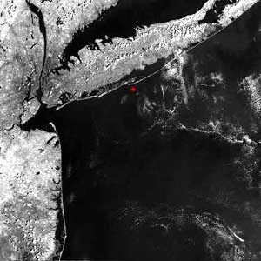
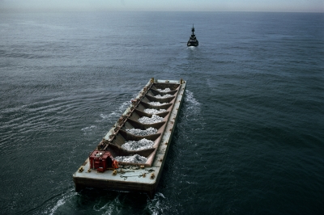
Betty Beaumont
Ocean Landmark, comprised of 17,000 coal fly-ash blocks, built in 1978-1980, is a unique artwork that recycles waste, establishes a habitat for fish, continues to feed people, and is a prototype for new industry. Ocean Landmark is an underwater work on the floor of the Atlantic, 40 miles from the New York Harbor, made of 500 tons of processed coal-waste, a potential pollutant transformed into a lush underwater garden. The work was inspired by the potential of the continental shelf and by a team of scientists experimenting to stabilize an industrial by-product in water. I proposed using their materials to create an underwater sculpture, that when fished, would feed people. It has grown and developed into a productive new ecosystem over the years and continues to evolve. -Betty Beaumont
http://www.schuylkillcenter.org/art/?page_id=281

Slide 4
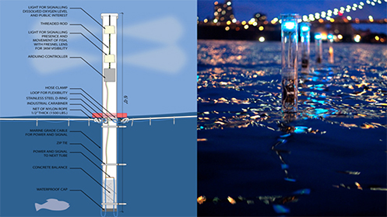
Natalie Jeremijenko
The idea, she says, is to design interfaces or write scripts that will “facilitate interactions between humans and nonhumans.”
https://www.nytimes.com/2013/06/30/magazine/the-artist-who-talks-with-the-fishes.html
Amphibious Architecture
Through a text-message feature, participants can correspond with fish and receive real-time data about water quality in response
http://www.spontaneousinterventions.org/project/amphibious-architecture.

Slide 5
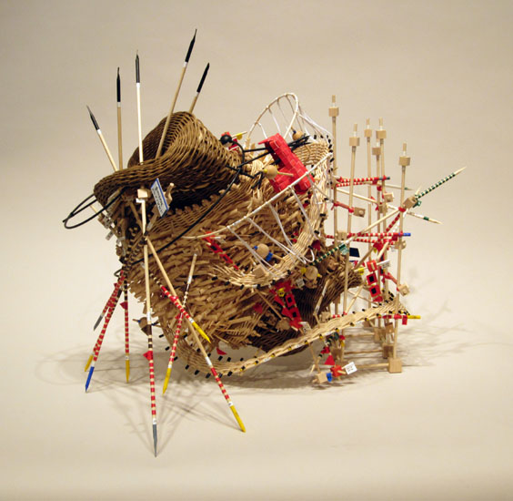
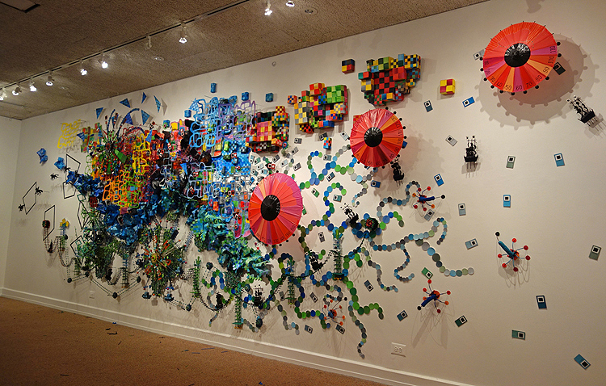
Nathalie Meibach
Nathalie uses weather data to create her installations
Sibling Rivalry II, 56'x10x1' (depth), 2017
Paper, wood, fibers, weather data.
Shown as installed at Agnes Scott College, Decatur, GA
(based on a flood)
And the Winds Kept Roaring Through the Night
(Oct 28, 1991 - Sable Island)
data, reed, wood
24" x 18" x 20", 2011
Based on ‘Perfect Storm’ of 1991

Slide 6
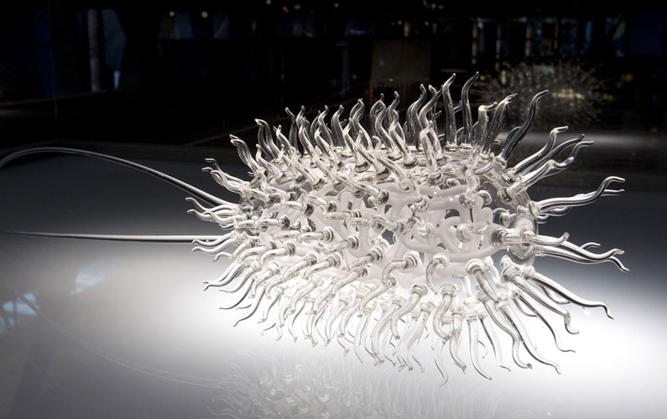
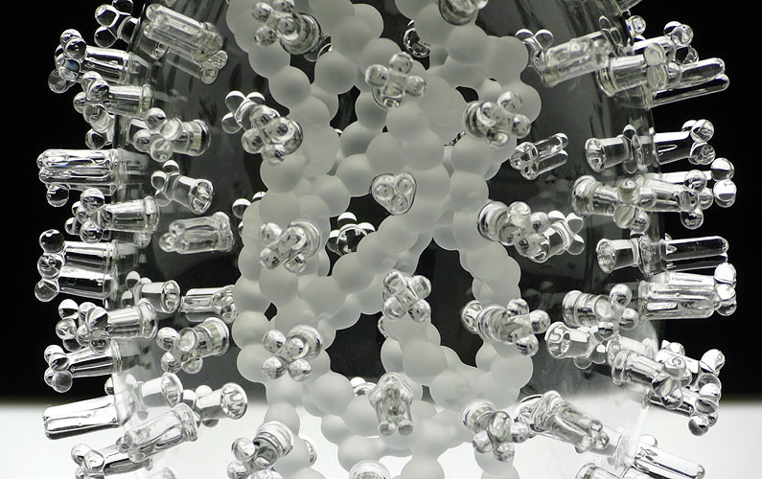
Luke Jerram
Glass Microbiology - Glass Microbiology is a body of glass work which has been developed by artist Luke Jerram since 2004. Made to contemplate the global impact of each disease, the artworks are created as alternative representations of viruses to the artificially coloured imagery received through the media. In fact, viruses have no colour as they are smaller than the wavelength of light. By extracting the colour from the imagery and creating jewel-like beautiful sculptures in glass, a complex tension has arisen between the artworks’ beauty and what they represent. - https://www.lukejerram.com/glass/about
Avian Flu
E. Coli

Slide 7
Other resources:
Resources to review on artists on microscopy:
The Designer Who Peered into Microscopes and Saw High Art
https://www.wired.com/2016/03/designer-peered-microscopes-saw-high-art/
Fire in Her Eyes
https://www.cell.com/pictureshow/art-under-the-microscope?code=cell-site
Beauty and the Microscope: What Science Can Learn From Art
https://theconversation.com/beauty-and-the-microscope-what-science-can-learn-from-art-80244
Creating Abstract Art with a Microscope
http://time.com/4279508/art-carl-struwe/
Artists who use water:
Eight Artists Conspire about Water in a New Exhibit (2016)
https://www.smithsonianmag.com/arts-culture/eight-artists-conspire-about-water-issues-new-exhibition-180958207/
The Artist Who Talks With the Fishes - Natalie Jeremijenko
https://www.nytimes.com/2013/06/30/magazine/the-artist-who-talks-with-the-fishes.html
TED Talk with Natalie Jeremijenko - The Art of the Eco-Mind Shift
https://www.ted.com/talks/natalie_jeremijenko_the_art_of_the_eco_mindshift

